Slide 1
T-distributed Stochastic Neighbor Embedding (t-SNE)
Higher understanding with lower dimensions – GLBIO 2019
Da-Inn Erika Lee

Slide 2
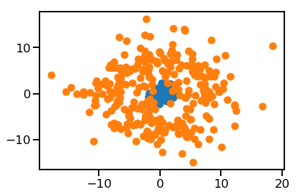
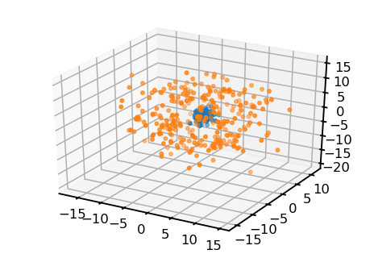
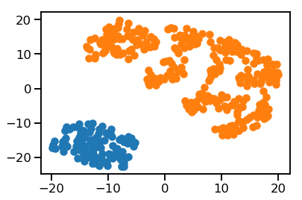
But can you untangle a hairball?
PCA
t-SNE

Slide 3




Intuition
“If I’m close to a neighbor in a higher dimensional space,
I also want to be close to it in a lower dimensional space;
if I’m far from a neighbor, it should also stay that way.”
$$d_{1}$$
2D to 1D
$$d_{1}^{′}$$
$$d_{2}$$
$$d_{2}^{′}$$

Slide 4
Breaking it down
Pick neighbors in the original space to help me find my place in the low dimensional space
Recreate my neighborhood in the low dimensional space
Push and pull until we get the distances between neighbors right

Slide 5
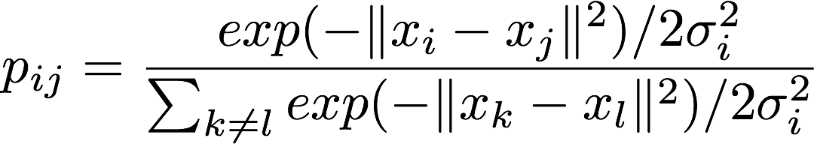

Pick neighbors
For a given data point $x_{i}$, the probability of picking $x_{j}$ as a neighbor:
i.e., you have less chance of picking a neighbor if they are far away.

Slide 6
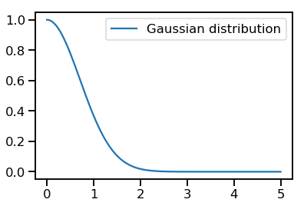
Pick neighbors
Note you pick with probability from a Gaussian distribution, rather than having a fixed set of neighbors.
This is the ”stochastic neighbors” part!

Slide 7
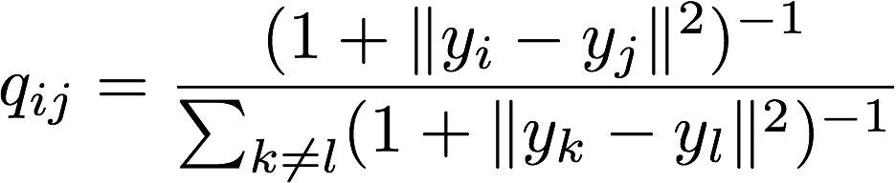

Recreating neighborhood
For $y_{i}$ (projection of $x_{i}$ in the lower dimensional space), the probability of picking $y_{j}$ (projection of of $x_{j}$) as a neighbor in the lower dimensional space:

Slide 8
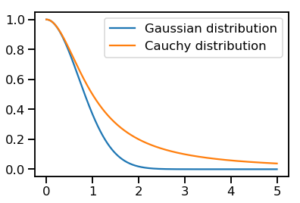

Recreating neighborhood
Why isn’t $q_{ij}$ also a Gaussian like $p_{ij}$? T distribution with 1 degree of freedom (a.k.a. Cauchy distribution) is more “spread out”, and will spread out very similar points so it’s easier to distinguish them in lower dimensional space.
This is the “t-distributed” part!

Slide 9
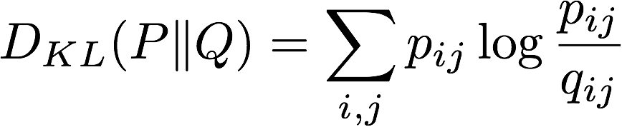
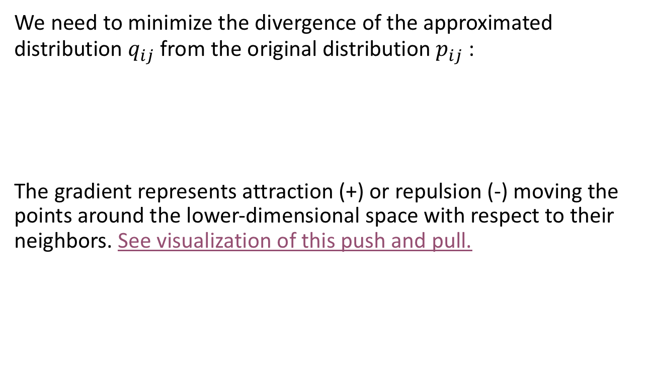
Push & Pull
We need to minimize the divergence of the approximated distribution $q_{ij}$from the original distribution $p_{ij}$:
The gradient represents attraction (+) or repulsion (-) moving the points around the lower-dimensional space with respect to their neighbors. See visualization of this push and pull.

Slide 10
Takeaways
t-SNE tries to preserve the distance between data points when the data is projected into lower dimensional space.
It is great for visualization, since it spreads out very similar points a little bit so it’s easier to see in 2D or 3D space.
R: https://cran.r-project.org/web/packages/Rtsne/index.html (Use ‘Rtsne’ NOT the ‘tsne’ package!)
Python: https://scikit-learn.org/stable/modules/generated/sklearn.manifold.TSNE.html
References:
https://mlexplained.com/2018/09/14/paper-dissected-visualizing-data-using-t-sne-explained/
https://www.oreilly.com/learning/an-illustrated-introduction-to-the-t-sne-algorithm
https://distill.pub/2016/misread-tsne/

